Slide 1







Wannier Function Based First Principles Method for Disordered Systems
Tom Berlijn, Wei Ku
postdoc
PhD
CMSN network

Slide 2













Collaborators
Theory
Dmitri
Volja
Chi-Cheng
Lee
Wei Ku
Chai-Hui
Lin
Wei-Guo
Yin
Limin
Wang
William
Garber
Experiment
Theory
Andrivo
Rusydi
Tun Seng
Herng
Dong
Chen Qi
Ding
Jun
Peter
Hirschfeld
Yan
Wang

Slide 3
Outline
Introduction: Super Cell Approximation
Method : Effective Hamiltonian (Wannier function) ^{[1]}
Application 1: e_{g}’ pockets of Na_{x}CoO₂ ^{[1]}
Application 2: oxygen vacancies in Zn_{1-x}Cu_{x}O_{1-y}^{[2]}
[1] T. Berlijn, D. Volja, W. Ku, PRL 106 077005 (2011)
[2] T. S. Herng, D.-C. Qi, T. Berlijn, W. Ku, A. Rusydi et al, PRL 105, 207201 (2010)

Slide 4
Introduction:
Super Cell Approximation

Slide 5
What kind of disorder?
Not like
But like
substitution
interstitial
vacancy

Slide 6
Goal: configurationally averaged spectral function of disordered systems from first principles
<A(k,w) > = S A(k,w)_{i}
config i
mean field vs super cell

Slide 7
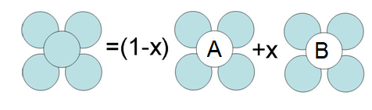
Mean Field¹
VCA: Virtual Crystal Approximation
V_{virtual crystal} = (1-x) V_{A} + x V_{B}
no scattering
CPA: Coherent Potential Approximation
non-local physics missing
A. Gonis, “Green functions for ordered and disordered systems” (1992)

Slide 8
non-local physics 1: k-dependent self-energy Σ(w,k)
w
k
but mean-field k-independent Σ(w)

Slide 9
non-local physics 2 : Large-sized impurity states (Anderson localization)

Slide 10
non-local physics 3 : Short Range Order

Slide 11
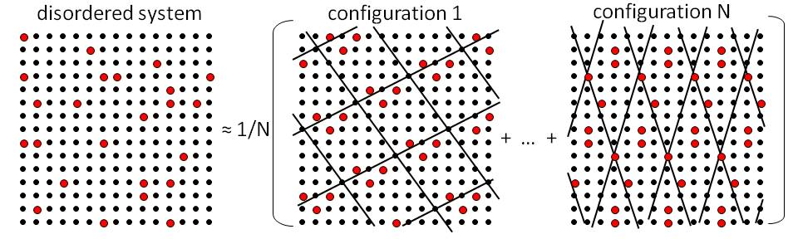
Approach: super cell approximation
<A(k,w) > ≈ 1/N ( A₁(k,w) + … + A_{N}(k,w) )
problem
solution
band folding
unfolding^{[1]}
computational expense
effective Hamiltonian
[1] W. Ku , T. Berlijn, and C.-C. Lee, PRL 104 216401 (2010)

Slide 12
Method:
Effective Hamiltonian
T. Berlijn, D. Volja, W. Ku, PRL 106 077005 (2011)

Slide 13
Concept: Linearity
disordered
undoped
linear
2-body
H = H⁰ + S_{i} D^{(i)} + S_{i,j} D^{(i,j)} + …
D^{(i)} = H^{(i)} - H⁰
D^{(i,j)} = H^{(i,j)} - D^{(i)} - D^{(j)} - H⁰
higher order moments

Slide 14
Construction
DFT doped & undoped
Wannier-transformation
Linear superposition

Slide 15
1) Density Functional Theory
two DFT Calculations
undoped
(normal cell)
1 impurity
(per super cell)
Influence impurity

Slide 16
2) Wannier transfomation
DFT undoped
2 Wannier transformations
|rn> = e^{-ik•r} U_{nj}(k) |kj>
Energy
kj
k
DFT 1 impurity
2 Tight Binding Hamiltonians
undoped
1 impurity
Energy
H_{dft}⁰
H_{dft}^{(i)}
K

Slide 17
3) Linear Superposition
Influence 1 impurity:
D^{(i)} = H_{dft}^{(i)} - H_{dft}⁰
effective Hamiltonian N impurities:
H_{eff}^{(1,…,N)} = H_{dft}⁰ + S_{i}D^{(i)}

Slide 18
Testing
DFT v.s. effective Hamiltonian

Slide 19
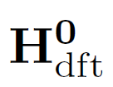
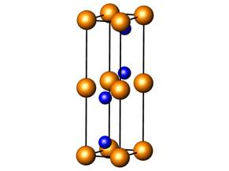
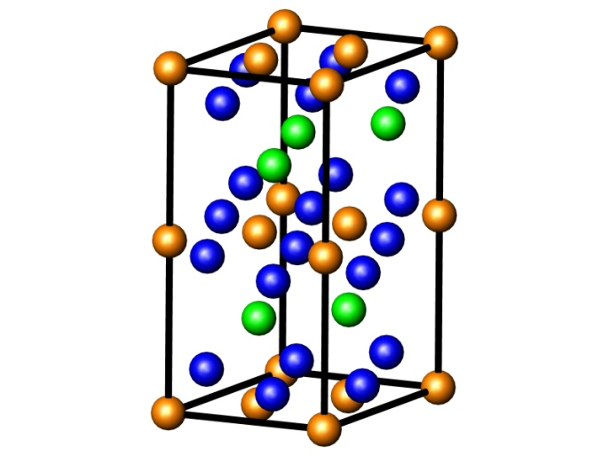
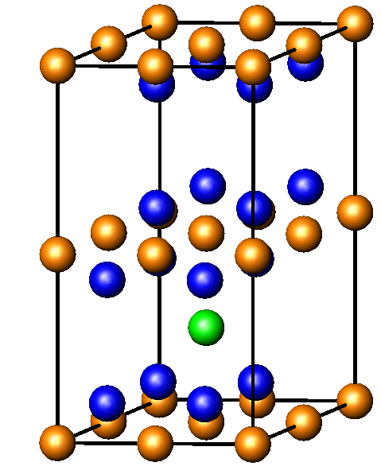
Test : Na_{x}CoO₂
x=0
x=2/3
x=1/8

Slide 20
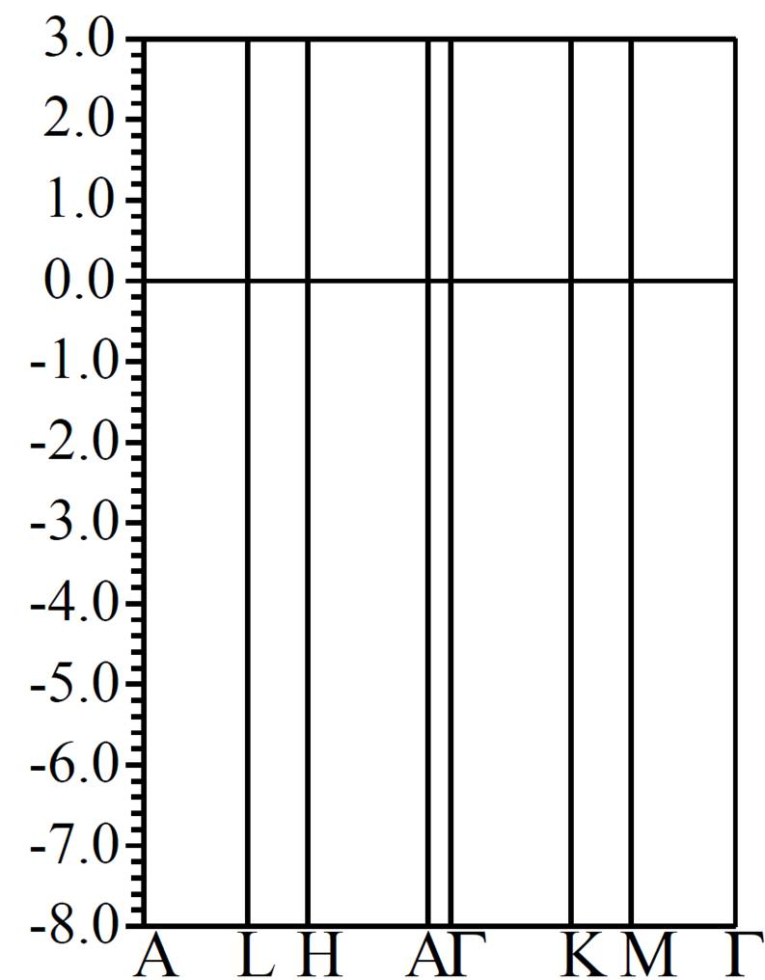
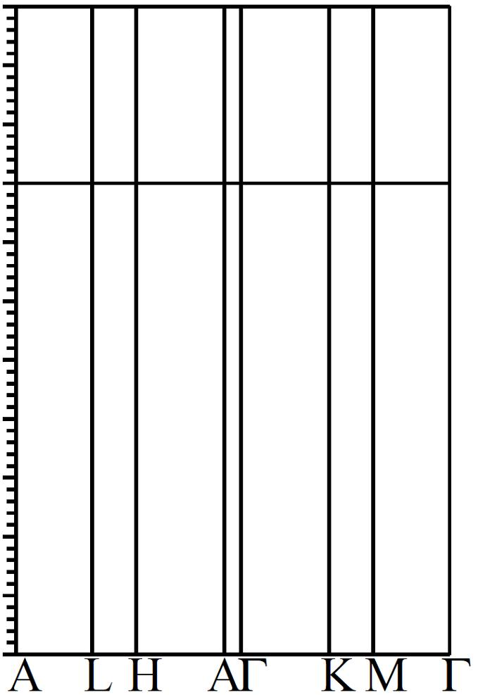
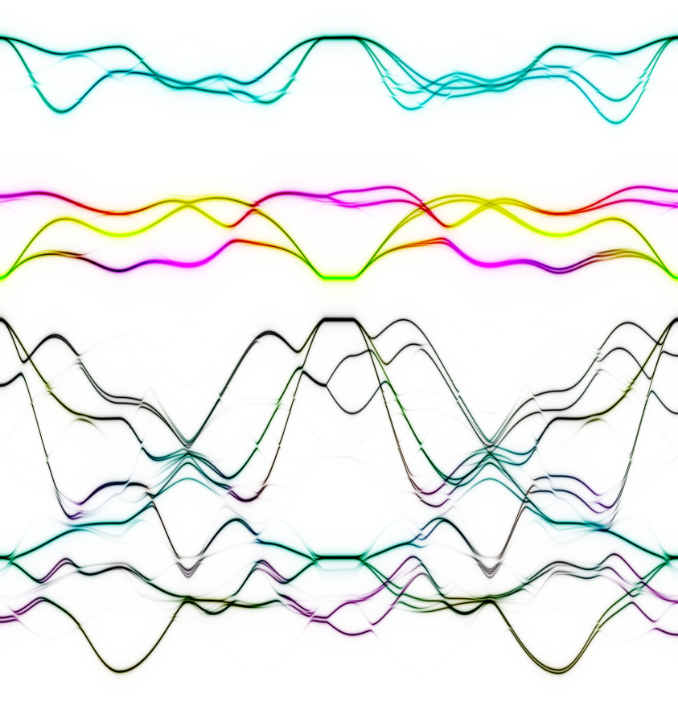
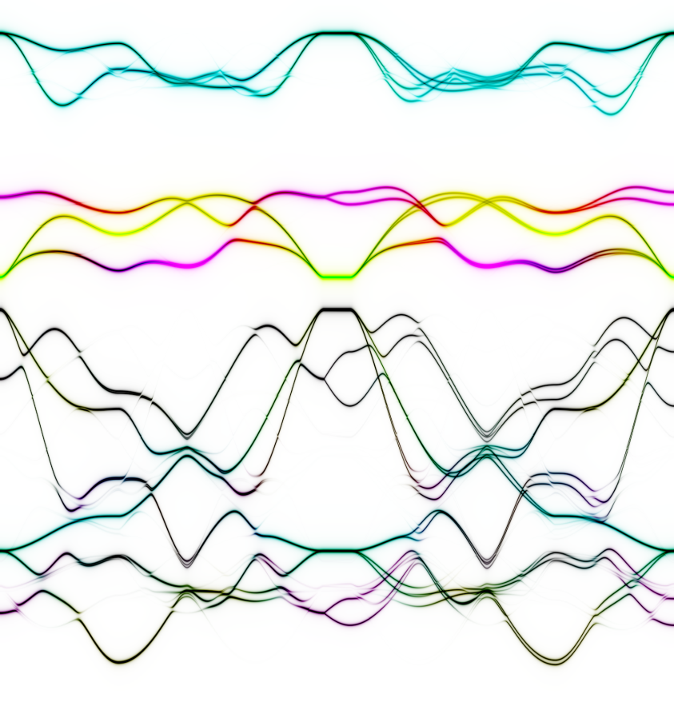


Test : Na_{x}CoO₂
DFT
Effective Hamiltonian
Energy (eV)
Co-e_{g}
Co-a_{g}
Co-e_{g}’
O-p
2019 LAPW’s + 164 LO’s
self consistency
66 Wanier Functions
1 diagonalization

Slide 21
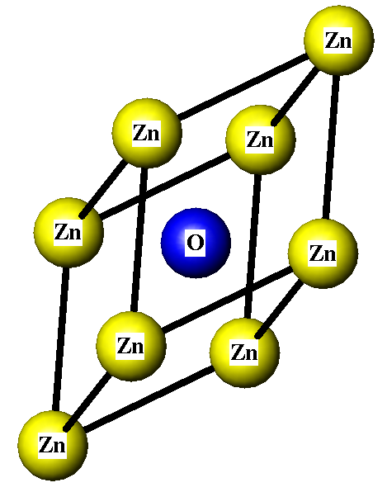
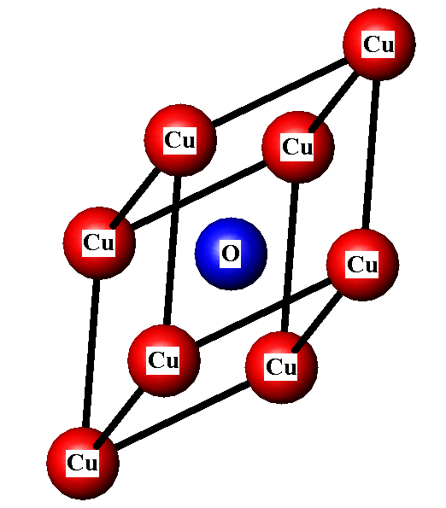
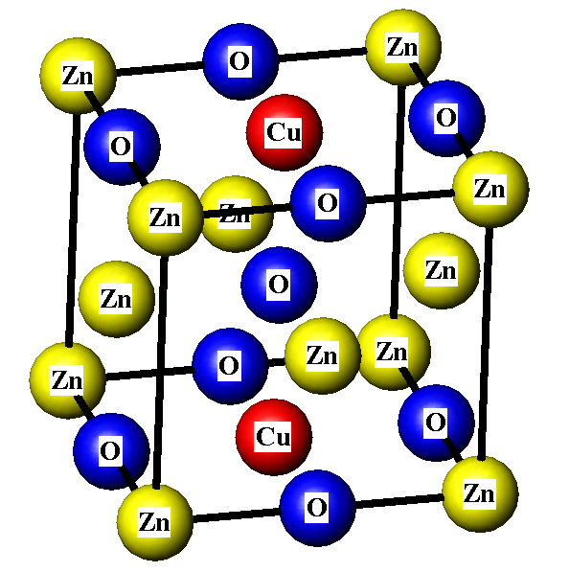
Test Zn_{1-x}Cu_{x}O (rock salt)
x=0
x=1
x=1/4

Slide 22


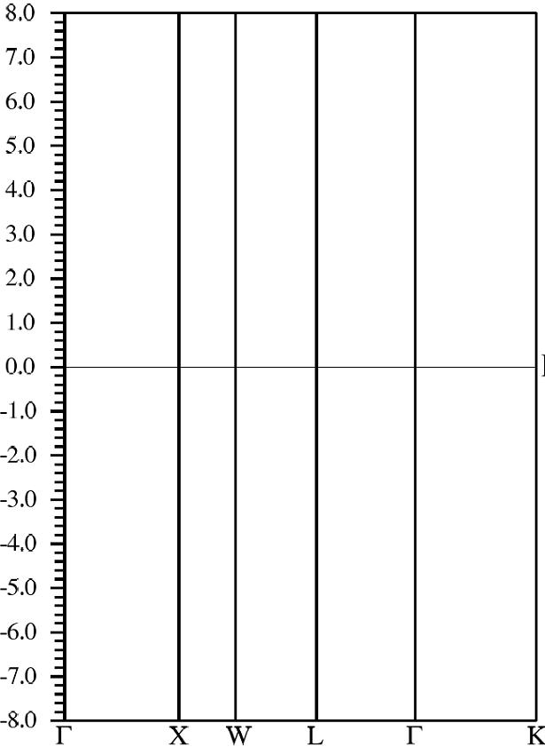
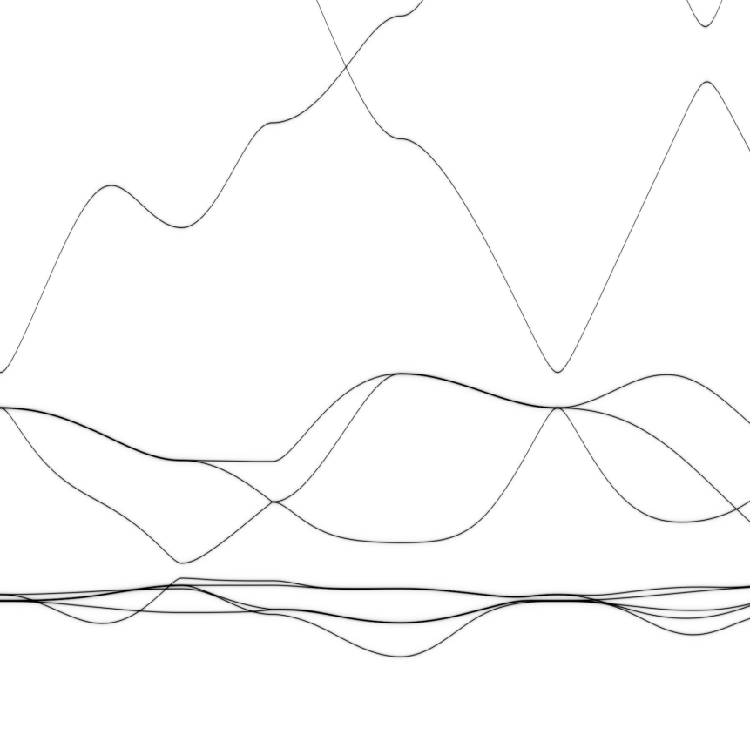
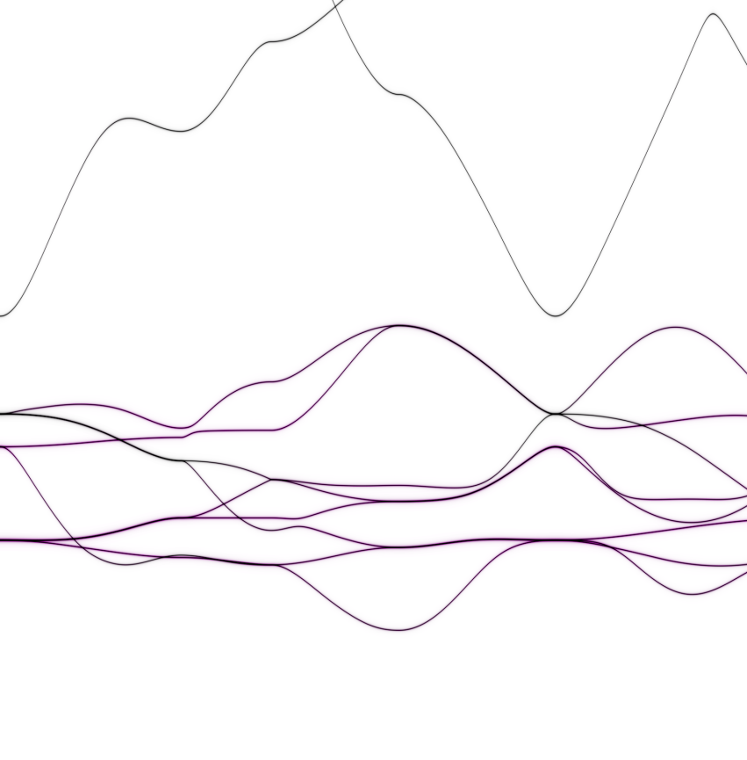
ZnO
CuO
Cu-d O-p hybrid
Cu-d
Zn-d

Slide 23

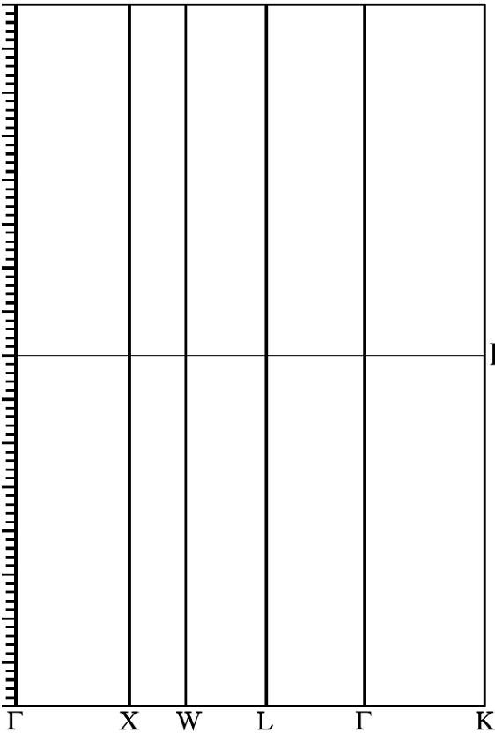
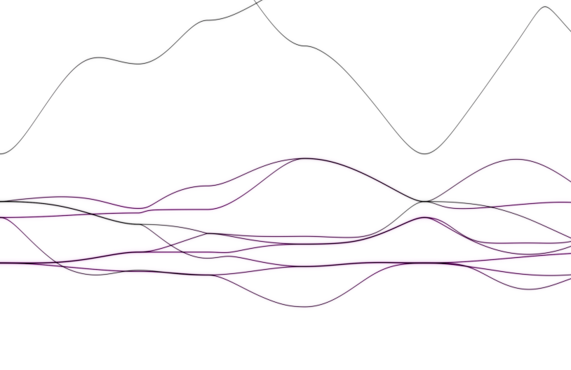
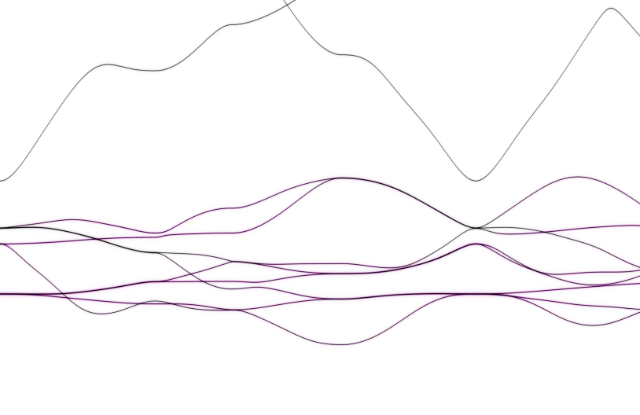
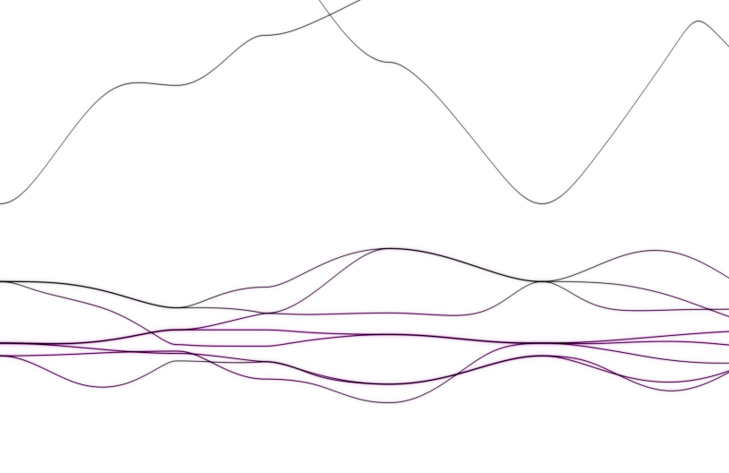
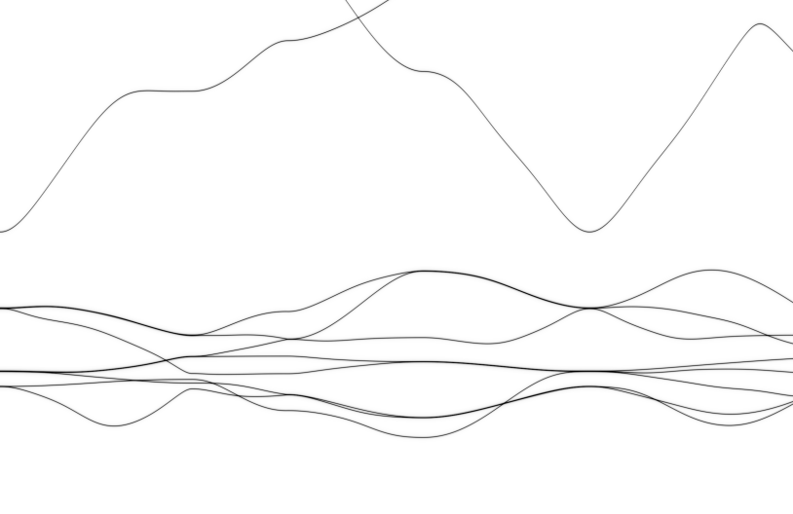
Test : Zn1-xCuxO (rock salt)
DFT
Effective Hamiltonian
spin
spin
8
8
4
4
0
0
-4
-4
-8
-8
Energy (eV)
spin
spin
8
8
4
4
0
0
-4
-4
-8
-8

Slide 24
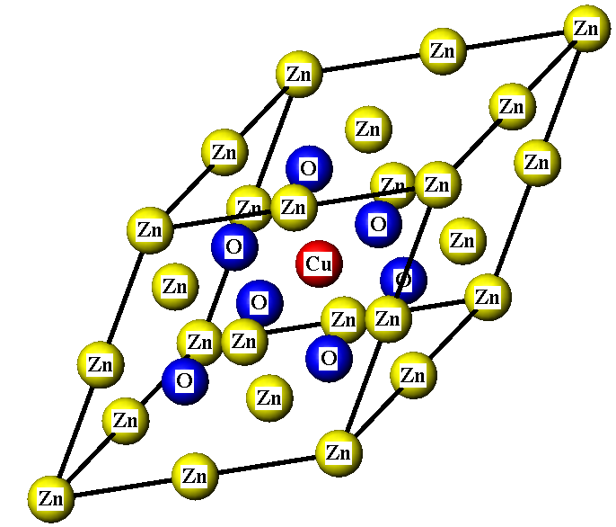
Test Zn_{1-x}Cu_{x}O (rock salt)
x=0
x=1/8
x=1/4

Slide 25
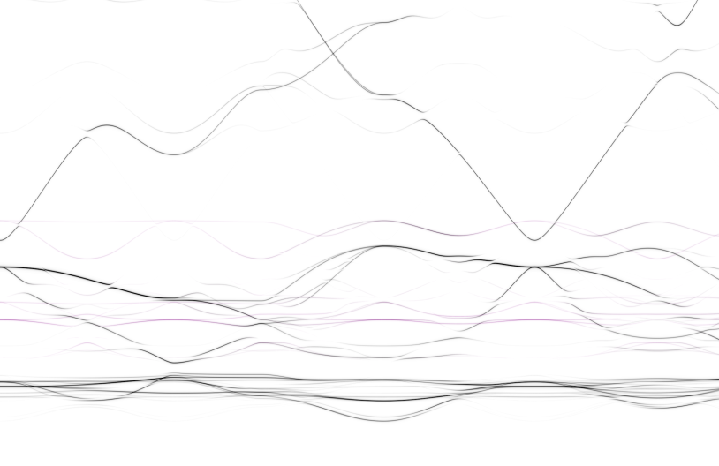
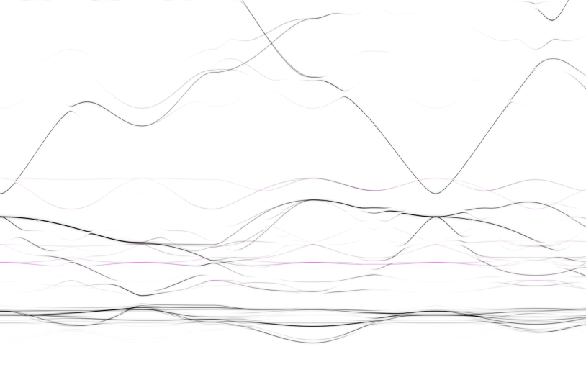
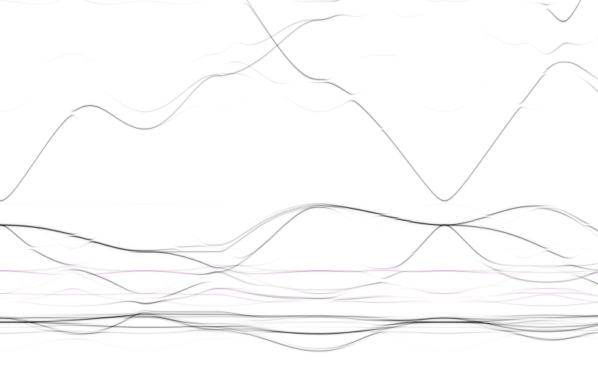
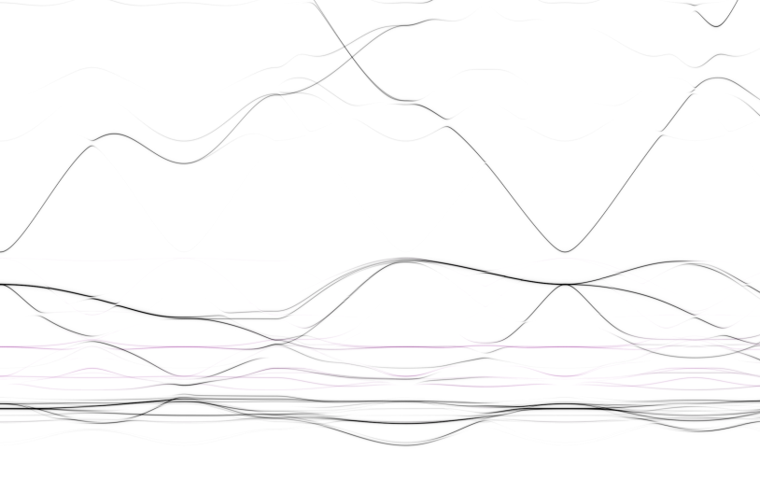
Test : Zn1-xCuxO (rock salt)
DFT
Effective Hamiltonian
spin
spin
8
8
4
4
0
0
-4
-4
-8
-8
Energy (eV)
spin
spin
8
8
4
4
0
0
-4
-4
-8
-8

Slide 26
Application 1:
e_{g}’ pockets of Na_{x}CoO₂
T. Berlijn, D. Volja, W. Ku, PRL 106 077005 (2011)

Slide 27
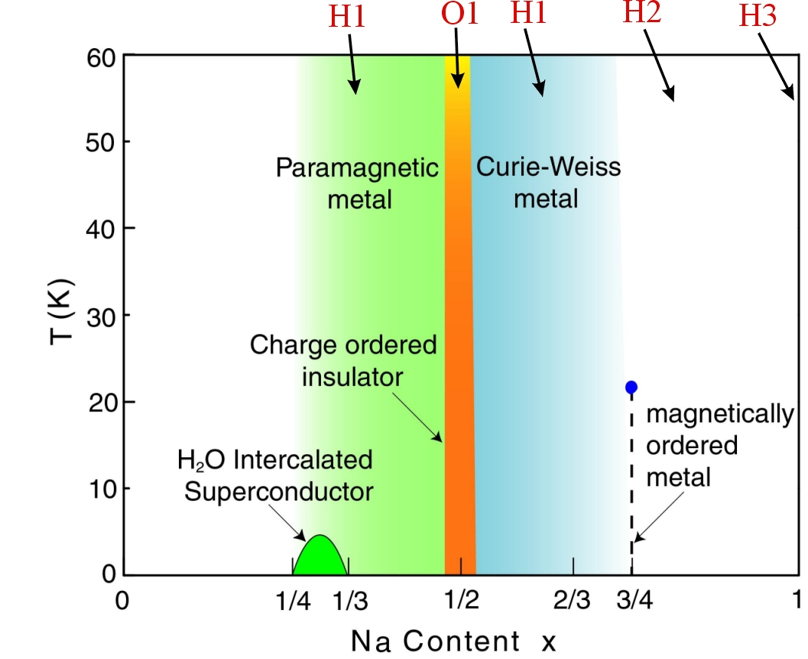
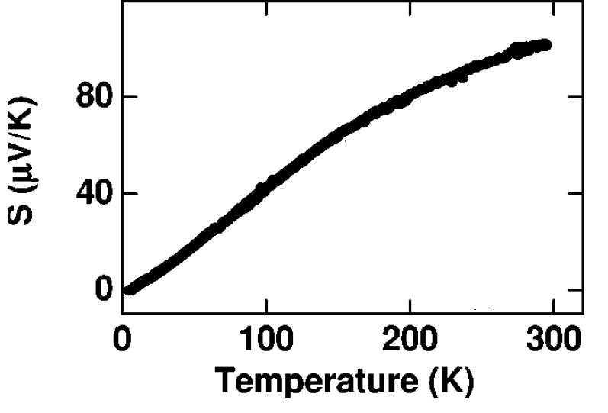
Why Na_{x}CoO₂?
High Thermoelectric Power¹
Unconventional Super Conductivity² ?
1) I. Terasaki et al, PRB 56 R12 685 (1997)
2) K. Takada et al, nature 422 53 (2003)

Slide 28
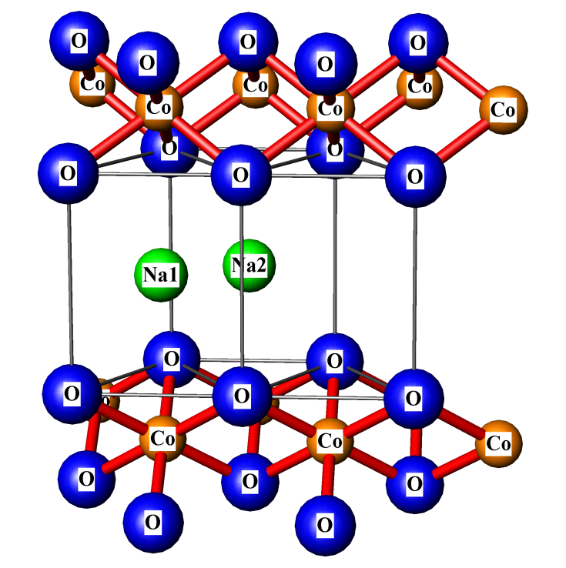
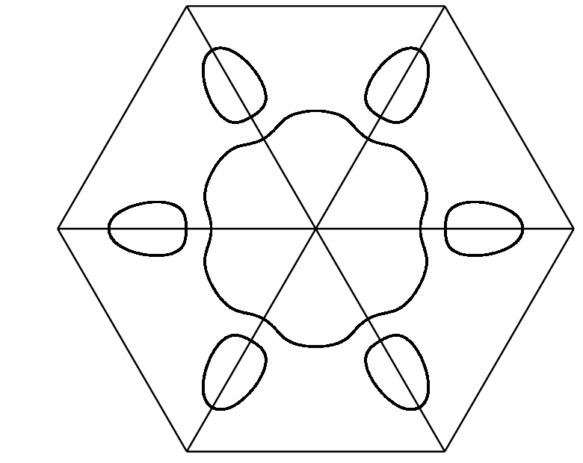
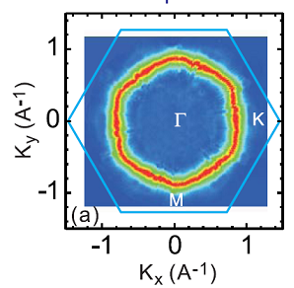
Intercalation: NaxCoO2
LDA¹
ARPES²
a_{g}
e_{g}’
Q) Does Na disorder destroy e_{g}’ pockets³ ?
D.J. Singh, PRB 20, 13397 (2000)
D. Qian et al, PRL 97 186405 (2006)
David J. Singh et al, PRL 97, 016404-1 (2006)

Slide 29
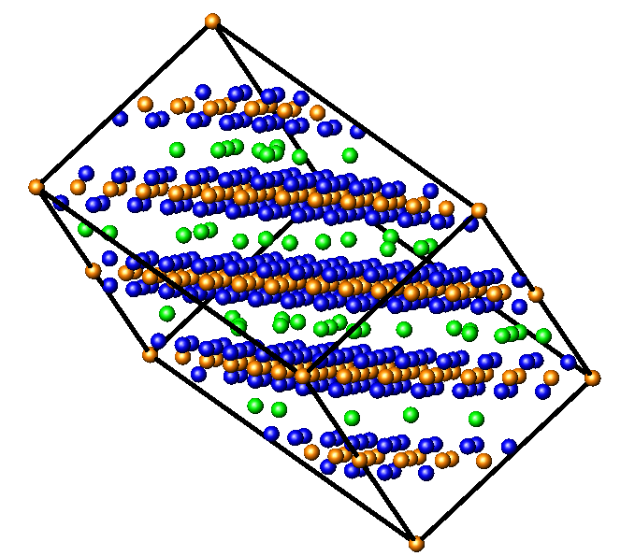
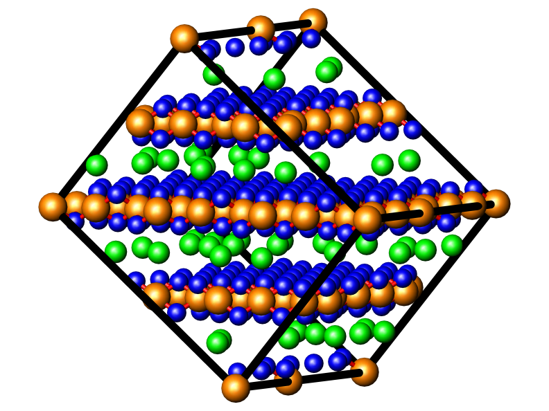


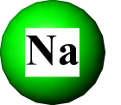
Na_{x}CO₂ : x0.30
50 configurations of ~200 atoms
configuration 1
configuration 50
+ . . . +

Slide 30
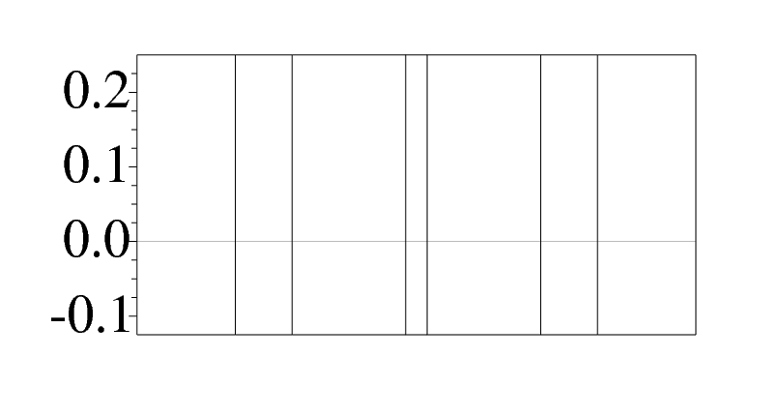
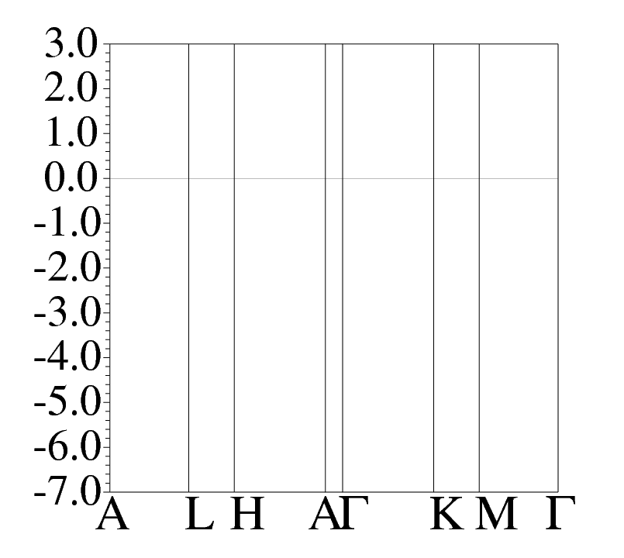
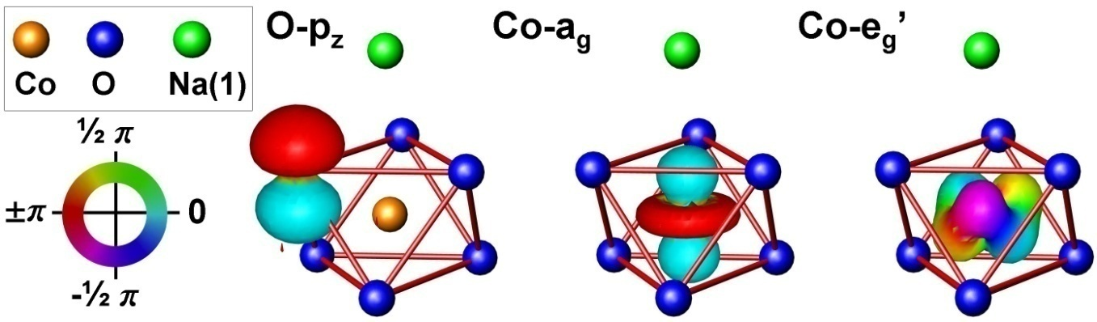
-0.2
0.0
0.2
Co-e_{g}’
-0.2
0.0
0.2
Co-a_{g}
Energy (eV)
-3.8
O-p
-4.0
-4.2
0.1
0.2
A) Na disorder does not destroy e_{g}’ ¹

Slide 31
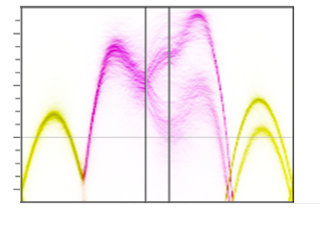
non-local physics :
k-dependent broadening
0.2
0.1
0.0
-0.1
Co-e_{g}’
Co-a_{g}
Energy (eV)
H A Γ K
k-dependent self energy Σ(k,w)?

Slide 32

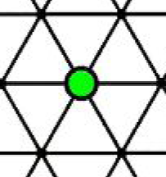
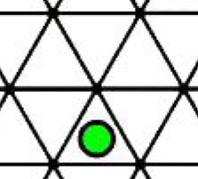
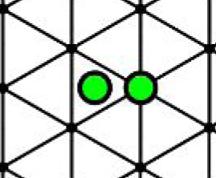
non-local physics :
short range order
Na(1) above Co
Na(2) above Co-hole
Simple rule: Na(1) can not sit next to Na(2):

Slide 33
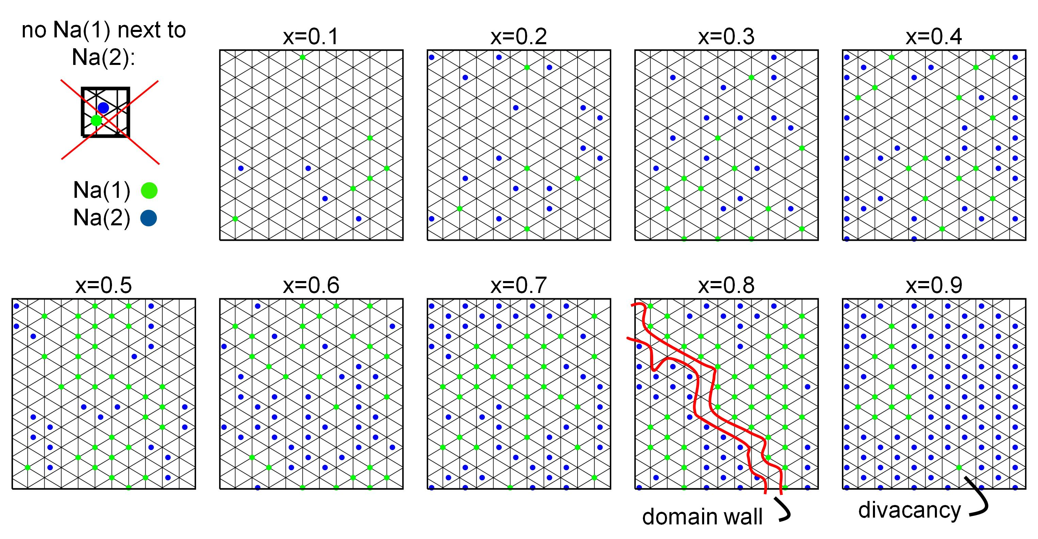

Slide 34
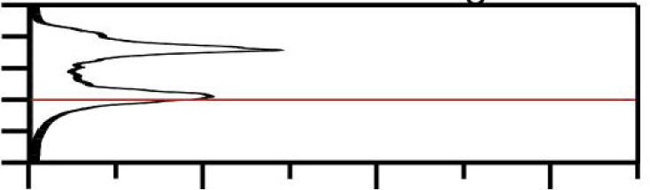
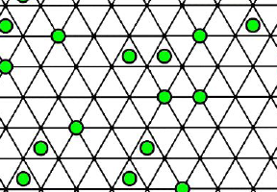
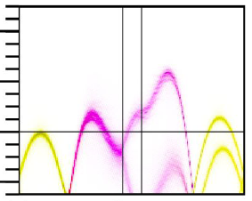
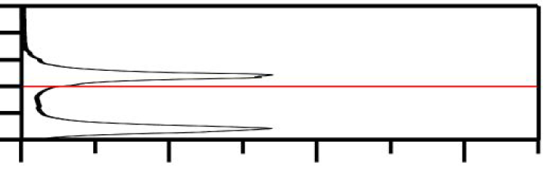
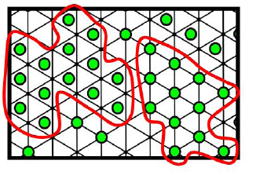
non-local physics :
short range order
A(k,w)
A(k₀,w) @ k₀=Γ
0.2
0.1
0.0
-0.1
0.3
0.2
0.1
0.0
-0.1
-0.2
X=0.30
Energy (eV)
H A Γ K
0.0 0.2 0.4 0.6
Na(2) island
Na(1) island
A(k,w)
A(k₀,w) @ k₀=Γ
0.3
0.2
0.1
0.0
-0.1
-0.2
0.2
0.1
0.0
-0.1
X=0.70
Energy (eV)
H A Γ K
0.0 0.2 0.4 0.6
SRO suppresses a_{g} broadening?

Slide 35
Application 2:
oxygen vacancies in Zn_{1-x}Cu_{x}O_{1-y}
T. S. Herng, D.-C. Qi, T. Berlijn, W. Ku, A. Rusydi et al, PRL 105, 207201 (2010)

Slide 36
Film growth & charactarization
Dr. T. S. Herng (NUS)
Prof. Ding Jun (NUS)
Beamline scientists
Dr. Gao Xingyu (NUS)
Dr. Yu Xiaojiang (SSLS)
Cecilia Sanchez-Hanke (NSLS)
XAS & XMCD
Dr. Qi Dongchen (NUS)
Prof. A. Rusydi (NUS)
Experiment
Microscopic
picture
First principles simulation
Wei Ku
Tom Berlijn

Slide 37
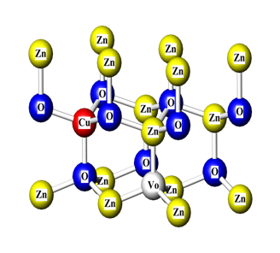
three representative films
ZnO
Cu:ZnO O-rich (2% Cu)
Cu:ZnO O-poor (2% Cu & ~1% oxygen vacancies V_{O})

Slide 38
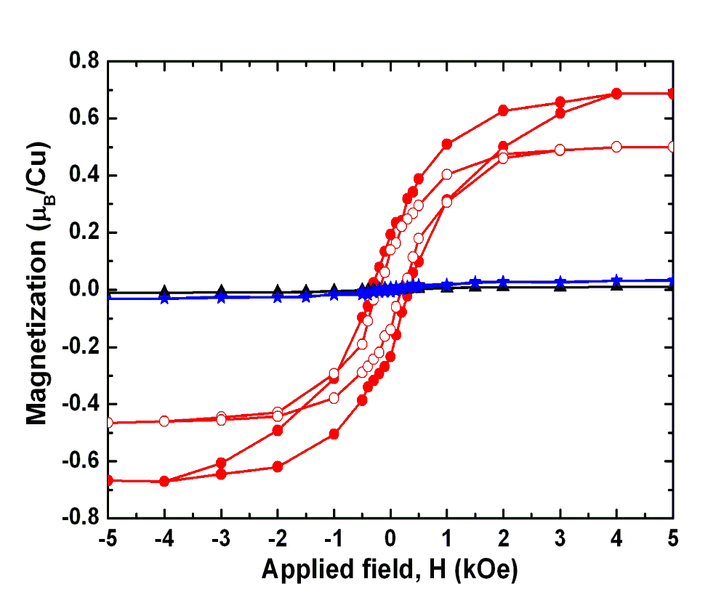

SQUID
ZnO @ 300K
ZnO:Cu @ 300K (O-rich)
ZnO:Cu @ 5K (O-poor)
ZnO:Cu @ 300K (O-poor)
Observation: oxygen vacancy induce FM @ 300K in Cu:ZnO
NB: 2 Cu-d9 + Vo = 2 Cu-d10
Q: what is the role of oxygen vacancies?

Slide 39
Q What is the influence of the oxygen vacancies?
oxygen vacancy = attractive potential + 2 electrons
Q ) Where do the electrons go?
one-particle spectral function <A(k,w)>
of Zn_{1-x}Cu_{x}O_{1-y} with attractive potential V_{O} but without its donated electrons

Slide 40
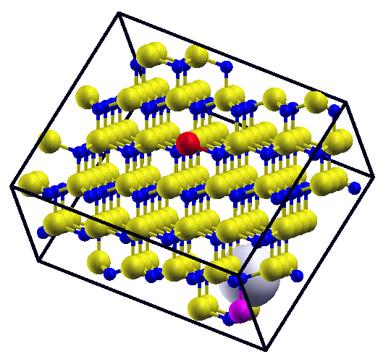






configurationally averaged spectral function
<A(k,w) > ≈ 1/10 ( A₁(k,w) + … + A₁₀(k,w) )
configuration 1
configuration 10
≈1/10
+….+
Zn Cu↓ Cu↑ O V_{O}

Slide 41



spectral function <A(k,w)>
<A↑(k,w)> <DOS↑(w)> <DOS↓(w)> <A↓(k,w)>
conduction band
Zn-4s
V_{O}
Energy (eV)
Cu-3d↑
valence band
O-2p
Cu-3d↓
Cu-3d x 40

Slide 42

Q) Where do the electrons go?
<A↑(k,w)> <DOS↑(w)>
Zn-4s
Cu-3d x 40
e⁻
Energy (eV)
V_{O}
Cu-3d↑
O-2p
A) Cu upper Hubbard level
(leaving V_{O} empty)

Slide 43

Oxygen vacancy states |V_{O}> are big
k-space
real-space
<A↑(k,w>
oxygen vacancy
wavefunction <x|Vo>
FWHM ≈ΓM/5
Zn-4s
Energy (eV)
V_{O}
Cu-3d↑
radius ≈ 2.5 a
O-2p
Cu-3d x 40

Slide 44



But why are oxygen vacancy states |V_{O}> so big?
real-space
k-space
<A↑(k,w>
Oxygen vacancy = attractive potential + 2 electrons
Attractive potential
Zn-4s
Energy (eV)
V_{O}
Zn
Cu-3d↑
O-2p
O
Attractive potential in the 4 neighboring Zn
Cu-3d x 40
|Vo> ≈ ½ (|Zn₁-s> +|Zn₂-s> +|Zn₃-s> +|Zn₄-s>)

Slide 45
First principles results
Electrons go into |Cu-d↑>
2. Oxygen vacancy states |V_{O}> are big
Microscopic picture
no vacancies
with vacancies
Cu d ⁹
Cu d ¹⁰
V_{O}
Conclusion: oxygen vacancies mediate the Cu moments

Slide 46
Outline
Introduction: Super Cell Approximation
Method : Effective Hamiltonian (Wannier function) ^{[1]}
Application 1: e_{g}’ pockets of Na_{x}CoO₂ ^{[1]}
Application 2: oxygen vacancies in Zn_{1-x}Cu_{x}O_{1-y}^{[2]}
[1] T. Berlijn, D. Volja, W. Ku, PRL 106 077005 (2011)
[2] T. S. Herng, D.-C. Qi, T. Berlijn, W. Ku, A. Rusydi et al, PRL 105, 207201 (2010)

