Slide 1
CC and CI in terms that even a Physicist can understand
Karol Kowalski
William R Wiley Environmental Molecular Sciences Laboratory and Chemical Sciences Division,
Pacific Northwest National Laboratory

Slide 2
How it started
Coester & Kummel (1958,1960)
Čižek (1966)
Paldus & Čižek (1971)
Bartlett
Monkhorst
Mukherjee
Lindgren
Kutzelnigg
… and many others

Slide 3
CC reviews
J. Paldus, X. Li, “A critical assessment of coupled cluster methods in quantum chemistry,” Advances in Chemical Physics 110, 1 (1999).
R.J. Bartlett, M. Musial, “Coupled-cluster theory in quantum chemistry,” Reviews of Modern Physics 79, 291 (2007).

Slide 4
What we want to solve
Many Particle Systems
Molecular/Atomic Physics, Quantum Chemistry
(electronic Schrödinger equations)
Solid State Physics
Nuclear Physics

Slide 5
Exact solution of Schrödinger equation
Weyl formula (dimensionality of full configuration interaction space) – exact solution of Schrödinger equation
n – total number of orbitals
N – total number of correlated electrons
S – spin of a given electronic state
Efficient approximations are needed
5

Slide 6
Approximate wavefunction (WF) methods
Hartree-Fock method (single determinant)
E_{HF} is used to define the correlation energy ΔE
ΔE=E-E_{HF}
In molecules E_{HF} accounts for 99% of total energy
but without ΔE making any reliable predictions is impossible
Correlated methods (going beyond single determinant description)
  Configuration interaction method (linear parametrizaton of WF)
  Perturbative methods (MBPT-n)
  Coupled Cluster methods
  and many other approaches

Slide 7
Many-Fermion Systems
Creation/annihilation operators
Second quantized form of the Hamiltonian (welcome to the Fock space)
Indices μ & ν designate the one particle states: in chemistry spinorbitals
F=
n times

Slide 8
Wick Theorem
The basic tool in deriving CC equations
Commutator of two operators A & B
In normal product of the operator string M (N[M]) all the creations operator are permuted to the left of all annihilation operators, attaching (+/-) phase depending on the parity of the required permutation.
represented by connected
diagrams only

Slide 9
Particle-hole formalism
Special form of the Bogoliubov-Valatin transformation (choosing a new Fermi Vacuum)
Slater determinant
i,j,k,… occupied single particle states
a,b,c, …. unoccupied single particle
states

Slide 10
CC and CI methods
CI formalism
reference function
(HF determinant)
Intermediate normalization
N stands for the number of electrons

Slide 11
CC and CI methods
CC method
Intermediate normalization
cluster amplitudes
For fermions the expansion for e^{T} terminates (Pauli principle)

Slide 12
CI and CC methods
Full CI and full CC expansions are equivalent (and this is the only case when CI=CC)
CI amplitudes are calculated from the variational principle while the
cluster amplitudes are obtained from projective methods

Slide 13
CC formalism
Working equations:
From Campbell-Hausdorff formula
We get

Slide 14
CC formalism
Separating the equations for cluster amplitudes from the equation for energy
Step1: we solve energy independent
equations for cluster amplitudes
Step 2 :having cluster amplitudes we
Can calculate the energy

Slide 15
Approximations: CCD
CC with doubles (CCD):

Slide 16
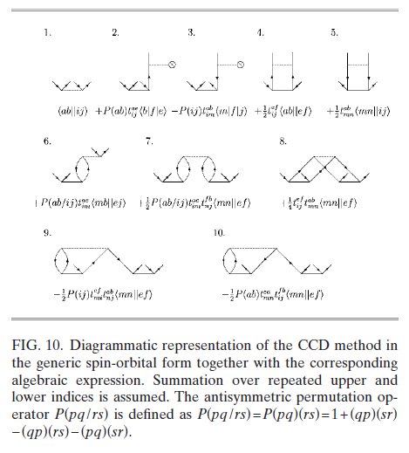
Approximations: CCD

Slide 17
Approximations: CCSD
CC with singles and doubles (CCSD):

Slide 18
CCSD and Thouless Theorem
Thouless theorem
CCSD wavefunction
CCSD provides better description of the static correlation effects (than the CCD approach)
two Slater determinants

Slide 19
CC approximations: CCSDT
CC with singles, doubles, and triples (CCSDT):

Slide 20
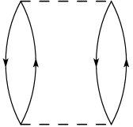
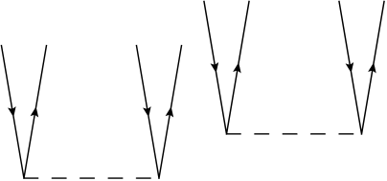
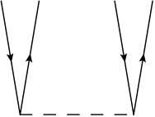
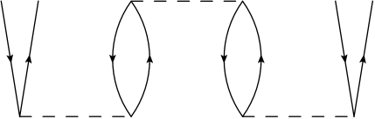
CC and Perturbation Theory (Linked Cluster Theorem)
Linked Cluster Theorem states:
  Perturbative expansion for the energy is expressed in terms of closed (having no external lines) connected diagrams only
  Perturbative expansion for the wavefunction is epxressed in terms of linked diagrams (having no disconnected closed part) only
Cluster operator T is represented by connected diagrams only

Slide 21
CC and Perturbation Theory
Enable us to categorize the importance of particular cluster amplitudes
Enable us to express higher-order contributions through lower-order contribution (CCSD(T))

Slide 22
CCSD(T) method
Driving force of modern computational chemistry (ground-state problems)
Belongs to the class of non-iterative methods
Enable to reduce the cost of the inclusion of triple excitations to n_{o}³n_{u}⁴ (N⁷) : required triply excited amplitudes can be generated on-the-fly.
Storage requirements as in the CCSD approach

Slide 23
Size-consistency of the CC energies
A
B
Cluster operator is represented by the connected diagrams only:

Slide 24
Numerical cost
Method | Numerical Complexity | Global Memory Requirements
CCSD | N⁶ | N⁴
CCSD(T) | N⁷ | N⁴
CCSDT | N⁸ | N⁶
CCSDTQ | N¹⁰ | N⁸

Slide 25
Equation-of-Motion Coupled Cluster Methods: Excited-State CC extension
cluster operator
reference function (HF determinant)
“excitation” operator
similarity transformed Hamiltonian

Slide 26
Equation-of-Motion Coupled Cluster Methods: Excited-State CC extension
EOMCCSD: singly-excited states
EOMCCSDT: singly and doubly excited states
Perturbative methods: EOMCCSD(T) formulations

Slide 27
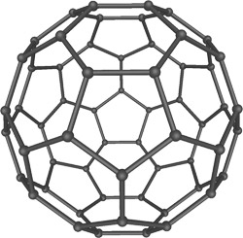
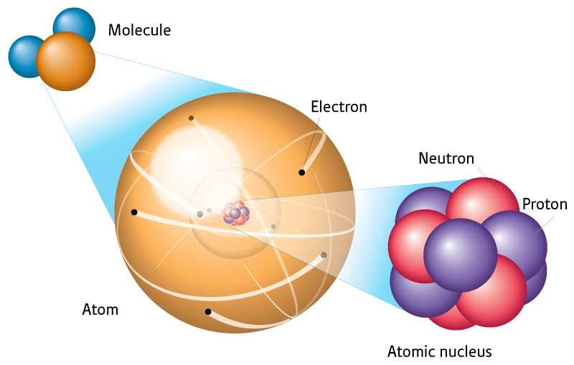
CC methods: across the energy and spatial scales
CC methods can be universally applied across energy and spatial scales!
Bartlett, Musial Rev. Mod. Phys. (2007)
Dean, Hjorth-Jensen, Phys. Rev. B (2004)

Slide 28
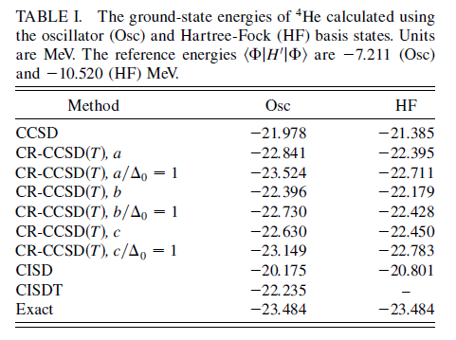
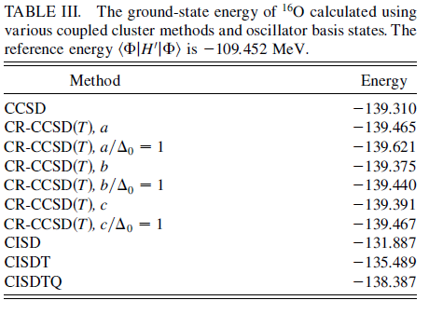
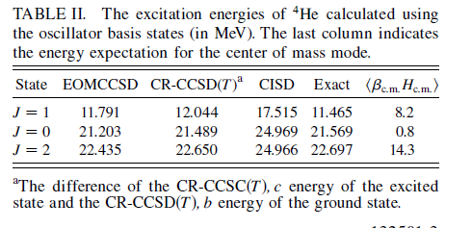
Performance of the CC methods
K. Kowalski,D.J. Dean, M. Hjorth-Jensen,
T. Papenbrock, P. Piecuch, PRL 92, 132501
(2004)

Slide 29
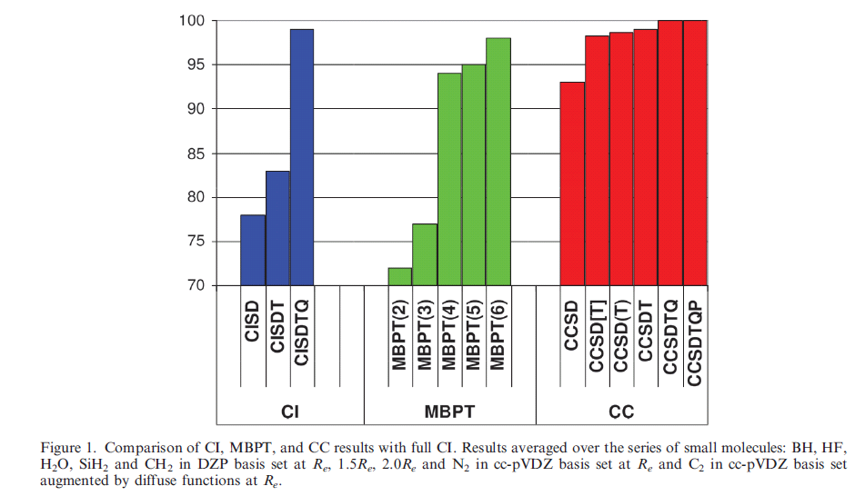
Performance of the CC method
R.J. Bartlett Mol. Phys. 108, 2905 (2010).

Slide 30
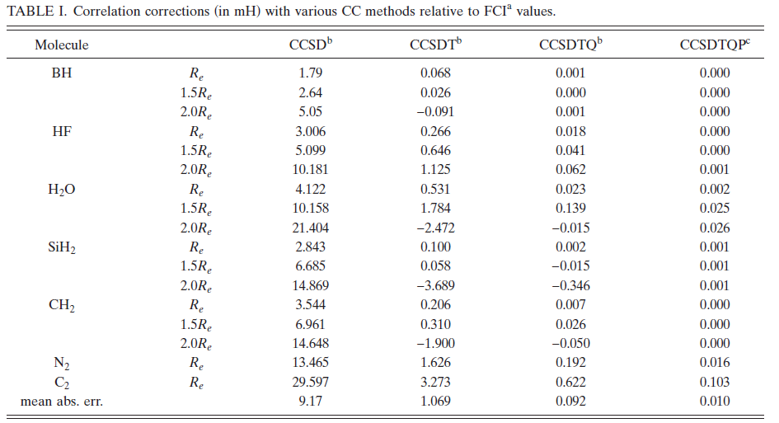
Performance of the CC methods
Bartlett & Musial, Rev. Mod. Phys.

Slide 31
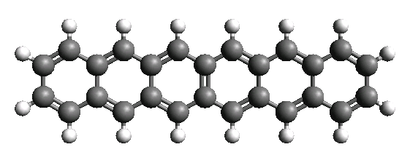
Illustrative examples of large-scale excited-state calculations – components of light harvesting systems

Slide 32
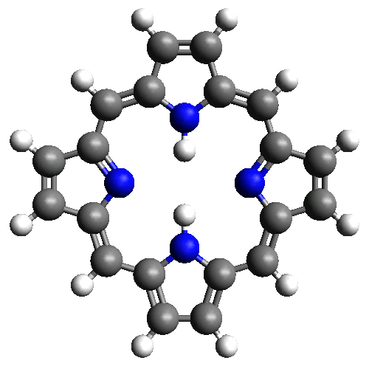
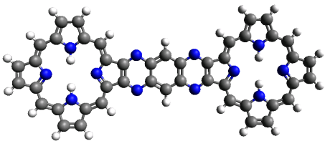
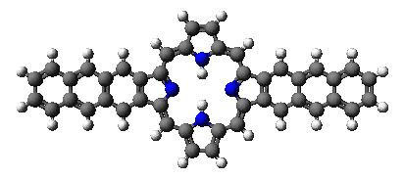
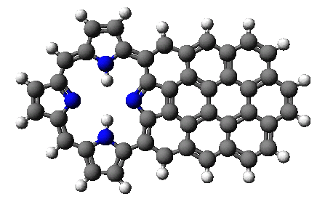
Functionalization of porphyrines
System | Leading excitations | CR-EOMCCSD(T) (eV)
 | H→ L, H-1→L+1 H-1→L, H→L+1 | 2.32 (Expt. 2.27 eV) 1.86 (Expt. 1.91 eV)
 | H→L, H-1→L+1, H-2→L+2, H-3→L+3 | 1.91 (Expt. 1.84 eV)
 | H→ L | 1.78
 | H→ L | 1.36
K. Kowalski, S. Krishnamoorthy, O. Villa, J.R. Hammond, N. Govind, J. Chem. Phys. 132, 154103 (2010); K. Kowalski, R.M. Olson, S. Krishnamoorthy, V. Tipparaju, E. Apra, J. Chem. Theory Comput. 7, 2200 (2011)

Slide 33
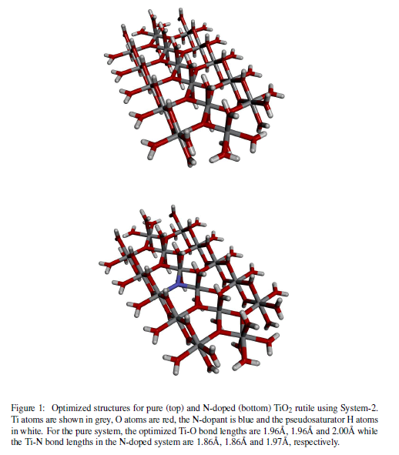
Multiscale Approaches: localized excited states in extended systems
Localized excited-states in materials
  catalysis
  photocatalytic decomposition of organic pollutants
  photolysis of water
  solar energy conversion
Visible Light Photoresponse of pure and N-doped TiO₂ (active-space EOMCCSD calculations, 400 correlated electrons):
TiO₂ EOMCCSd ➔ 3.84 eV
N-doped TiO₂ EOMCCSd ➔ 2.79 eV
N. Govind, K. Lopata, R. Rousseau, A. Andersen, K. Kowalski, J. Phys. Chem. Lett. “Visible Light Absorption of N-Doped TiO₂ Rutile Using (LR/RT)-TDDFT and Active Space EOMCCSD Calculations,” J. Phys. Chem. Lett. 2, 2696 (2011).

Slide 34
Why CC method is so popular in computational chemistry (and less popular in physics)???
Simpler form of the interactions (1/r)
CC functionalities are available in many quantum chemistry packages
  ACES III (parallel)
  CFOUR (some pieces in parallel)
  DALTON (serial)
  GAMESS (CCSD/CCSD(T) – parallel)
  Gaussian (serial)
  MOLPRO (parallel)
  NWCHEM (parallel)
  PQS (CCSD/CCSD(T) – parallel)

Slide 35
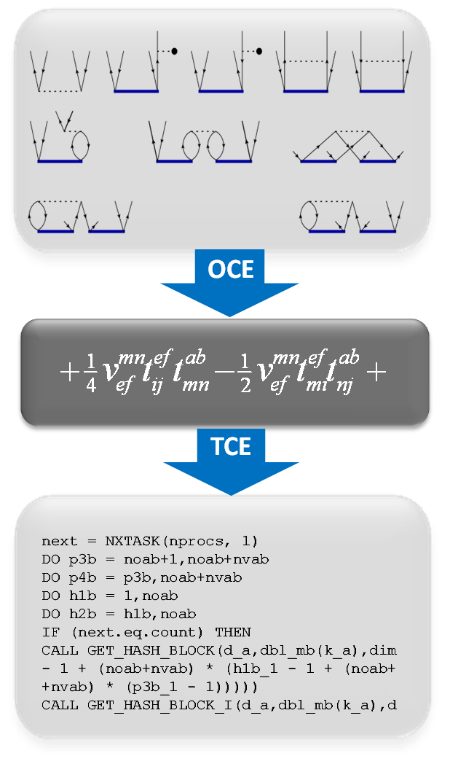
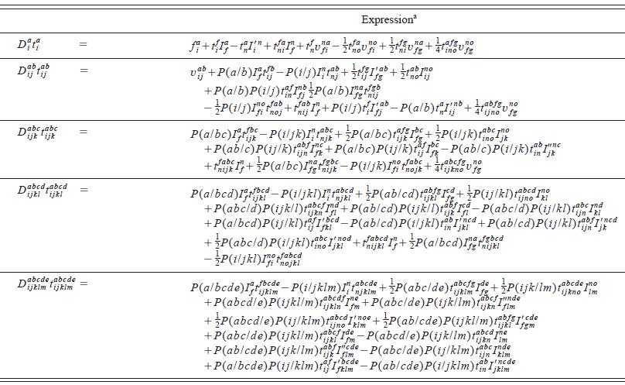
Tensor Contraction Engine (TCE)
Highly parallel codes are needed in order to apply the CC theories to larger molecular systems
Symbolic algebra systems for coding complicated tensor expressions: Tensor Contraction Engine (TCE)

Slide 36
Parallel performance
Parallel structure of the TCE CC codes
Tile structure:
S1 S2 …
S1 S2 …
S1 S2 ……….
S1 S2 ……….
Occupied spinorbitals
unccupied spinorbitals
Tensor structure:
36

Slide 37
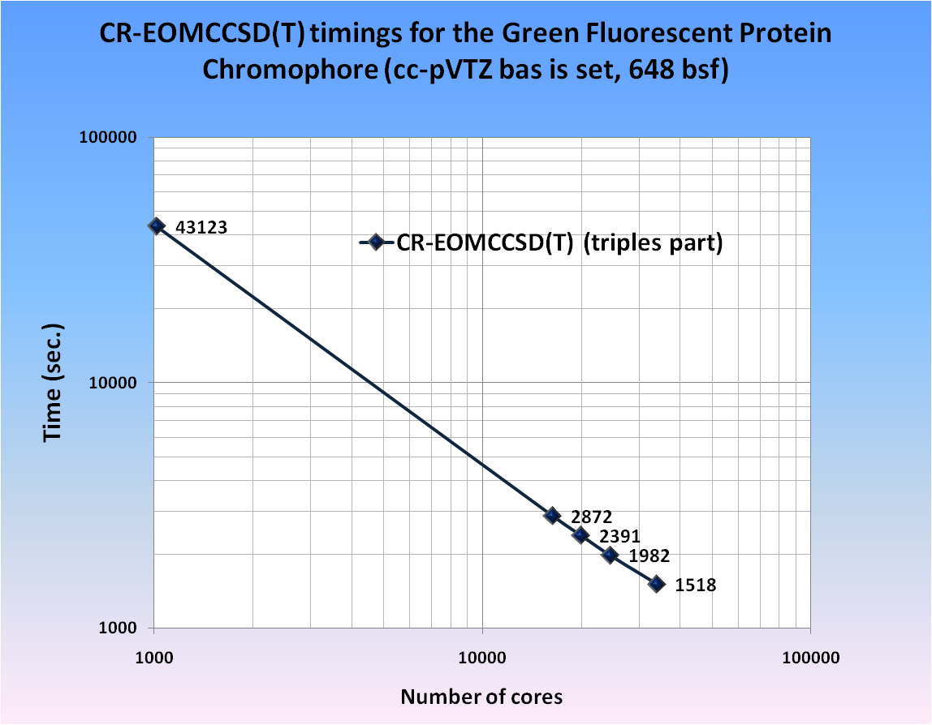
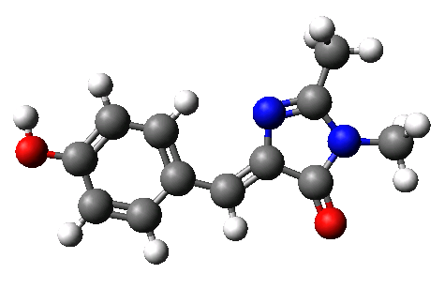
Parallel performance
An example of the scalability of the triples part of the CR-EOMCCSD(T) approach for GFPC described by the cc-pVTZ basis set (648 basis set functions). Timings were determined from calculations on the Franklin Cray-XT4 computer at NERSC using 1024, 16384, 20000, 24572, and 34008 cores).

Slide 38
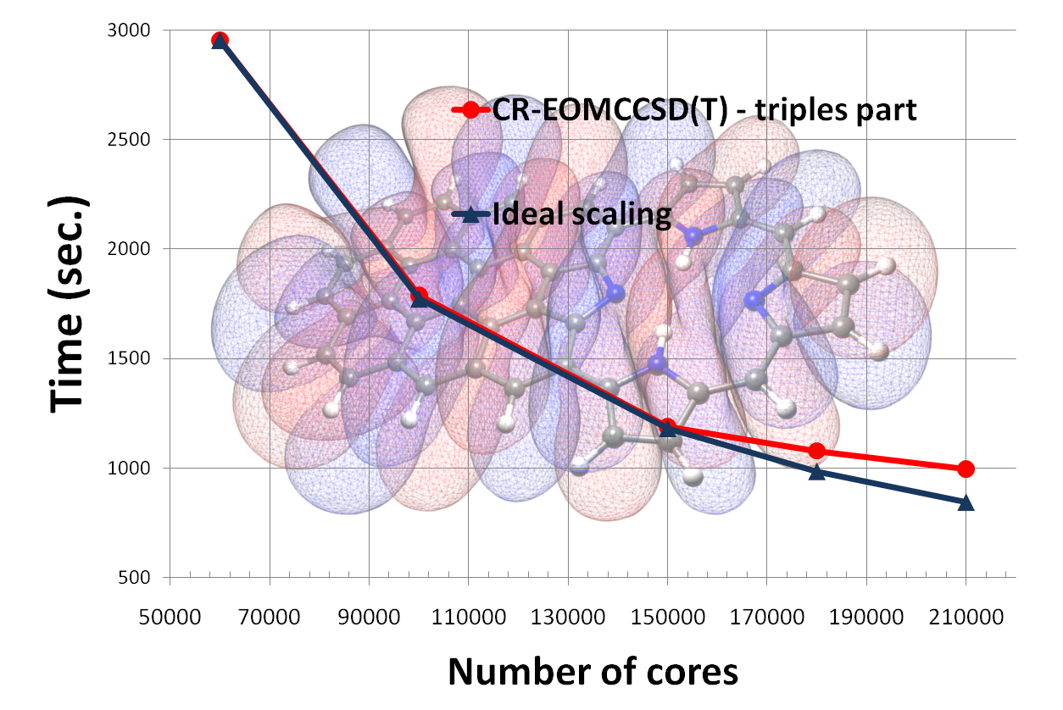
Scalability of the non-iterative EOMCC code
94 %parallel efficiency using 210,000 cores
Scalability of the triples part of the CR- EOMCCSD(T) approach for the FBP-f-coronene system in the AVTZ basis set. Timings were determined from calculations on the Jaguar Cray XT5 computer system at NCCS.

Slide 39
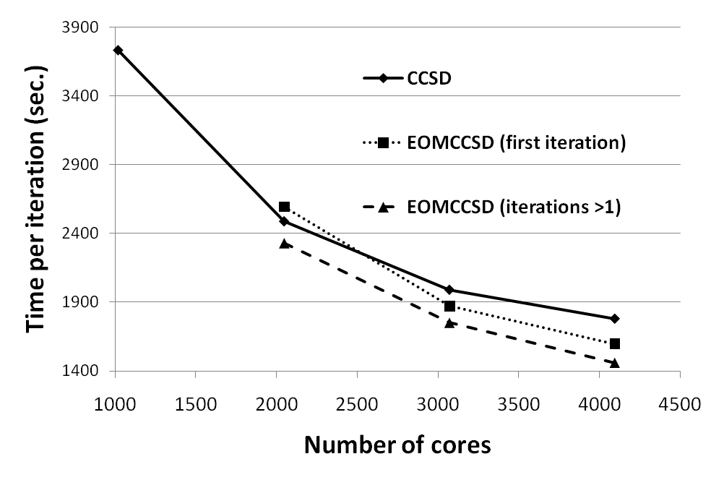
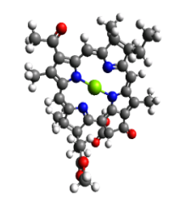
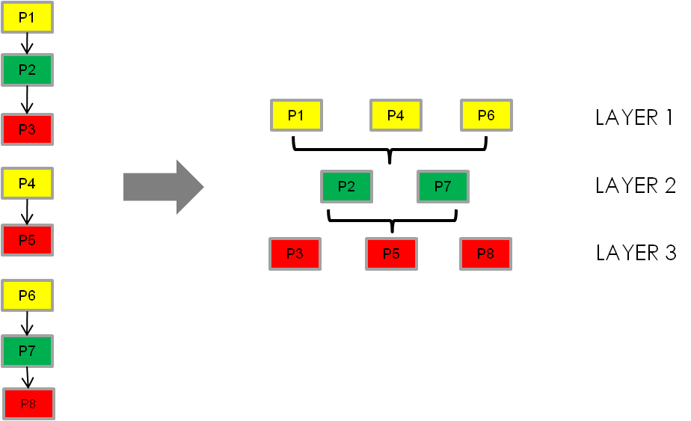


Scalability of the iterative EOMCC methods
Alternative task schedulers
  use “global task pool”
  improve load balancing
  reduce the number of synchronization steps to absolute minimum
  larger tiles can be effectively used
Notes:
Came up with a new design of the iterative part which provides better load balancing
Reducing the synch steps
Subsent iteration
This particular desing may be prevailing in design of the next generation of TCE
Global Map of tasks

Slide 40
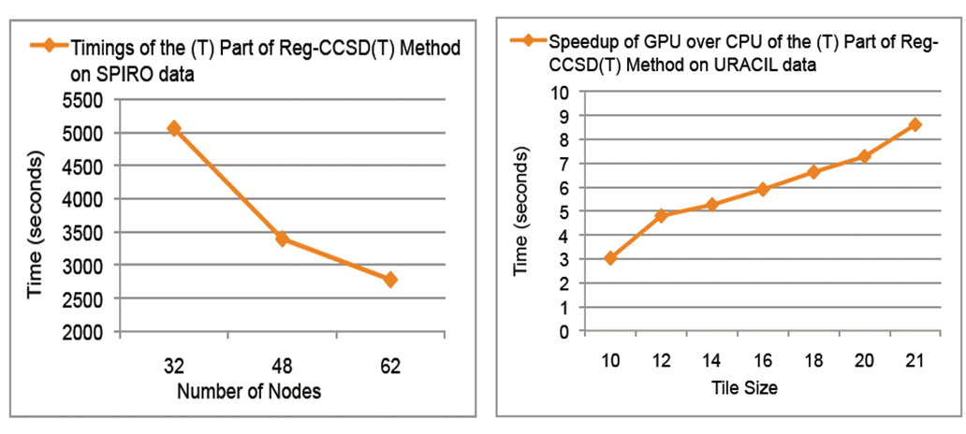
Towards future computer architectures
The CCSD(T)/Reg-CCSD(T) codes have been rewritten in order to take advantage of GPGPU accelerators
Preliminary tests show very good scalability of the most expensive N⁷ part of the CCSD(T) approach
speedup

Slide 41
Concluding remark
If you know the nature of the interactions in your system there is a good chance that the CC methods will give you the right results for the right reasons (assuming you have an access to a large computer)

Slide 42
THANK YOU

