Slide 1
DFT and strong correlation?
Kieron Burke
Departments of Physics and of Chemistry
UC Irvine
http://dft.uci.edu

Slide 2
Outline
Part I: Generalities
  Why its important to bridge worlds
  Strong versus weak correlation
  What is exact DFT?
Part II: Some specific projects
  Conduction through Anderson junction
  How DMRG might help
  Parition theory
  Continuum limit
Conclusions

Slide 3
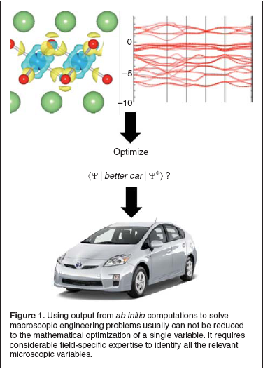

Better Li batteries?

Slide 4
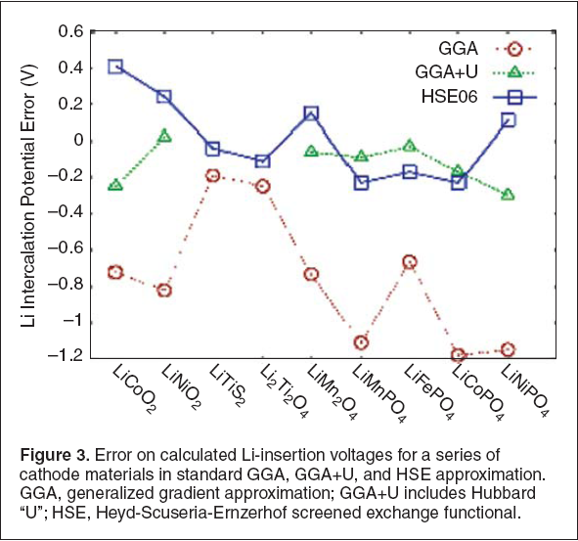
Materials genome from first principles?

Slide 5
Strong correlation

Slide 6
H₂ at equilibrium
Can tackle with traditional QC methods or DFT
Want highly accurate energetic differences (within .05 eV) and bond lengths (within 1pm)
QC is redproducible: Give method and basis, and everyone gets same result (to meV).
DFT less accurate and systematic, but inexpensive

Slide 7
1d H_{n} chain at equilibrium
Classic example for band theory
One e⁻ per site, so half-filled band
Appears to be a metal, regardless of bond length

Slide 8
Stretched H₂
As R->∞, electrons localize
All single determinant methods fail to dissociate to right limit
Can break spin-symmetry to get right energies
Simple 2-site Hubbard model (U), but this is minimal basis model, so not chemically accurate

Slide 9
1d H_{n} stretched chain
As a grows, get Mott-Hubbard transition
Always have zero gap in band theory, but finite gap in reality
Fundamental gap: I-A, I=ionization potential, A=electron affinity.
Need strong correlation, or electron localization, to make this happen.

Slide 10
Definition of strong correlation?
Many-body theorist: Anything LDA gets wrong.
Chemist: So H₂⁺ is strongly correlated?
Answer: Yes, if you take an infinite lattice of them.
Kieron’s working definition: KS spectral function qualitatively different from true spectral function

Slide 11
Weak versus Strong
Most of chemistry
Non-exotic materials
E.g., bulk Si
Physics well-known, but quantitative accuracy energies needed
Often DFT based, with CC, etc. for benchmarks
Dream of ab initio calculation of material-specific properties
Mostly materials
Exotic effects: Heavy fermions, superconductivity, etc.
Physics must be figured out.
Explain overall trends and universal behavior
Treat with model Hamiltonians and empirical parameters

Slide 12
DFT

Slide 13
Background in density functional theory (DFT)
Method for handling electron-electron repulsion by subterfuge
Basic theorems: Hohenberg-Kohn, Kohn-Sham prove you can extract exact ground-state energy and density n(r) from an effective single-particle calculation
All useful applications: Need to approximate unknown E_{XC}[n].

Slide 14
Kohn-Sham equations (1965)
ground-state density of interacting system
=

Slide 15
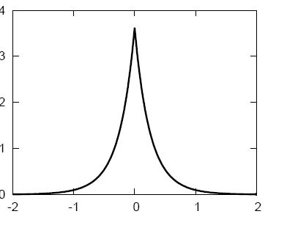
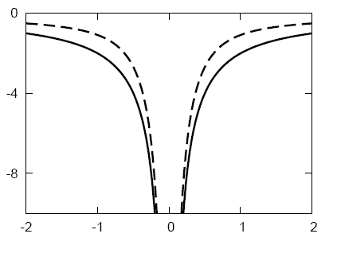
He atom in Kohn-Sham DFT
Everything has (at most) one KS potential
, E_{g}^{KS}
, E_{g}^{KS}
Dashed-line:
EXACT KS potential

Slide 16
Two different gaps
Exact theorem: ε_{HOMO} =-I, but ε_{LUMO}≠ -A
Fundamental gap:
  E_{g} = I – A (= 24.6eV for He atom)
Kohn-Sham gap:
  E_{g}^{KS} = ε_{HOMO}-ε_{LUMO} = 21.16 eV for He atom
Derivative discontinuity: Δ_{xc}= E_{g} - E_{g}^{KS}
NOTE: Both same if non-interacting, but different when interacting

Slide 17
Band gap ‘problem’ in ground-state DFT
Typically, E_{g}^{KS} much smaller than I-A (half for Si, makes Ge metallic)
Usually E_{g}^{HF} is much larger than I-A
Imagine you use exact functional
From orbital energies, all you see is E_{g}^{KS}
LDA/GGA yield accurate E_{g}^{KS}
Problem is not an ‘error’ of DFT
Can get E_{g} by adding and subtracting e⁻ from large cluster, but LDA/GGA just give same as E_{g}^{KS}, because no discontinuity.

Slide 18
HF versus EXX
HF minimizes E_{x} [{φ_{i}}] over all possible wavefunctions
EXX includes additional constraint of common potential (i.e., KS)
Yield almost identical ground-state energies, with HF lower
Occupied orbital energies very similar, but big difference in unoccupied orbital energies

Slide 19
Gaps with orbital-dependent functionals
EXX gives KS gaps that are closer to fundamental gap than LDA for common semiconductors
But consensus forming that inclusion of correlation shrinks E_{g}^{KS} back closer to LDA value
If you do a hybrid calculation using HF instead of EXX, get about ¼ way toward E_{g}^{HF}, which is an improvement, such as HSE
But not approximating E_{g}^{KS} anymore; called generalized KS and approximates GW

Slide 20
What is or is not DFT?
Exact Exchange and hybrid functionals
  If OEP method used to construct KS potential, then pure DFT; if HF, then not, but negligible difference for gs energy
Self-Interaction-Corrected (SIC) DFT
  Mildly illegal, as not invariant under orbital rotation
DFT+U
  Highly illegal, but very physical, but ambiguity about U
GW
  Simple many-body screening, improves gaps, but not reproducible
Dynamical Mean-Field Theory
  Not DFT or even close to it.

Slide 21
Part II
1d world and DMRG
Molecular conductance
Partition theory
Continuum limit of all matter

Slide 22
1d world and DMRG
Slides shamelessly stolen from Miles Stoudenmire and Lucas Wagner
In collaboration with Steve White

Slide 23
Basic idea
Using an exact numerical solver for 1d systems (known as DMRG), we can learn more about density functional theory (DFT) and find ways to make it better

Slide 24
Problems with DFT

Slide 25
Basic ingredients

Slide 26
Basic advance: DMRG in real-space

Slide 27
Three types of things to do

Slide 28
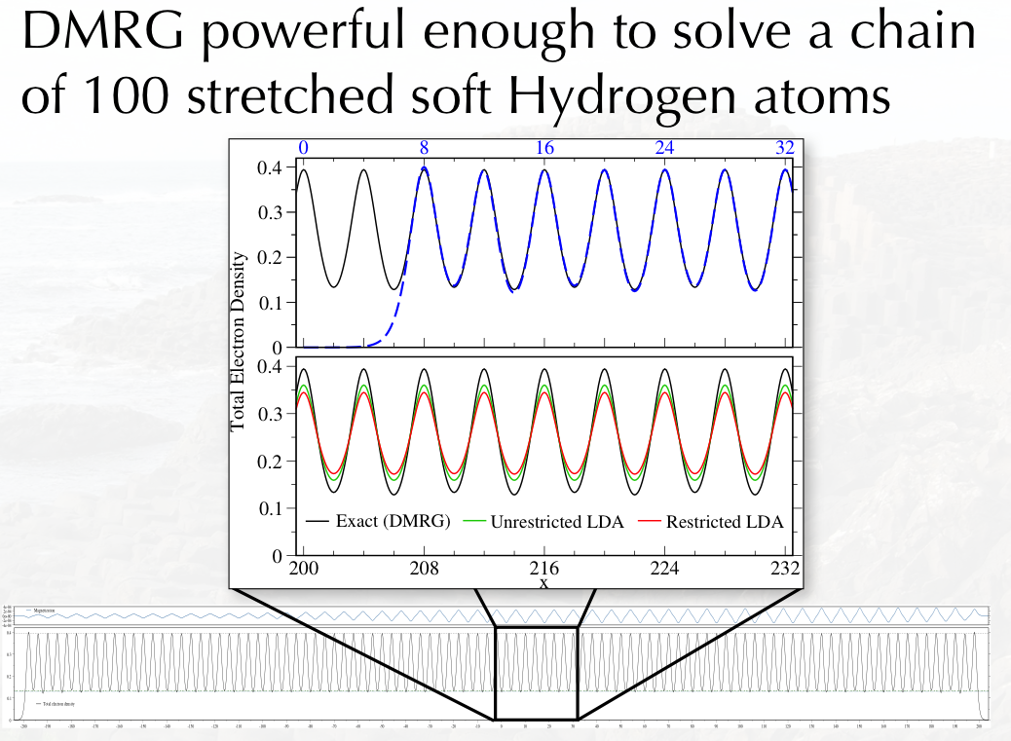
Example of long chains

Slide 29
Eg KS gap versus real gap

Slide 30
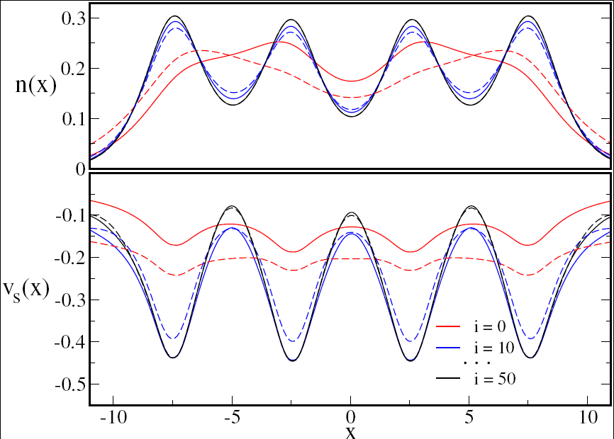
First ever KS calculation with exact E_{XC}[n]
Used DMRG (density-matrix renormalization group)
1d H atom chain
Miles Stoudenmire, Lucas Wagner, Steve White
On arXiv

Slide 31
Conduction through single molecules
Justin Bergfield, Zhenfei Liu, in collaboration with
Charles Stafford (U Arizona)

Slide 32
Standard approach: Combine ground-state DFT with Landauer
Apply Landauer formula to ground-state KS potential
Calculate transmission as a function of energy
Not really non-equilibrium Greens functions
Just ground-state DFT for KS potential and transmission through that.

Slide 33
And…where’s Coulomb blockade?
Electron hops on to molecule
Reduces current because charging stops a second electron until potential can overcome charging
Move levels on molecule by applying gate voltage
Get CB `diamonds’

Slide 34
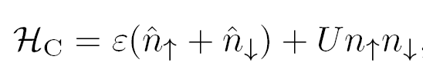



Hamiltonian for Anderson junction
One-site molecule, with central H:
Coupled to two baths of electrons, each in wide-band limit, with energy-independent self-energy contributions Г

Slide 35
Effects in Anderson junction
For ε ≠ μ, transmission lessened.
In restricted Hartree-Fock, change in density produces transmission bump of approximate width U when U large
U >> Г, coupling to leads is weak and correlation on molecule is strong
U ≈ Г, coupling to leads is moderate and correlation on molecule is moderate

Slide 36
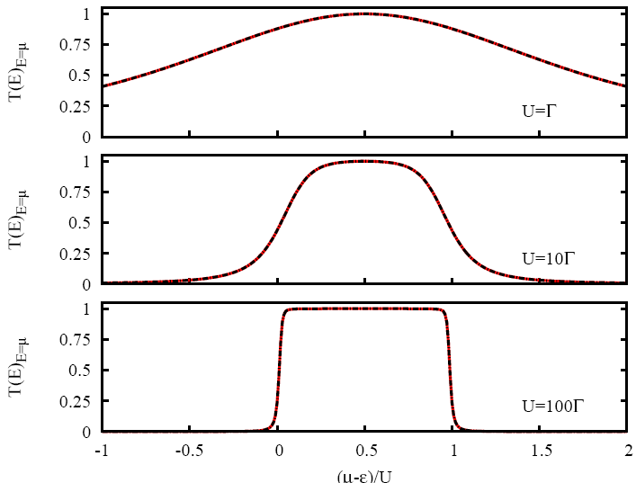
Exact Transmission from Bethe Ansatz (T=0)

Slide 37
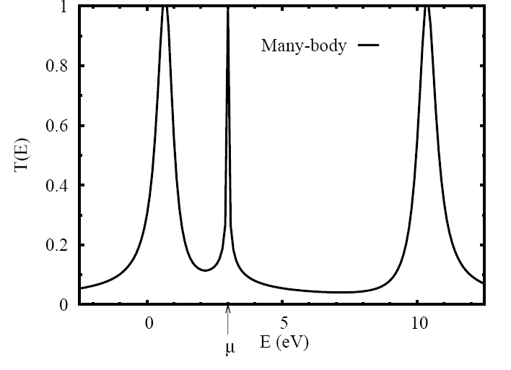
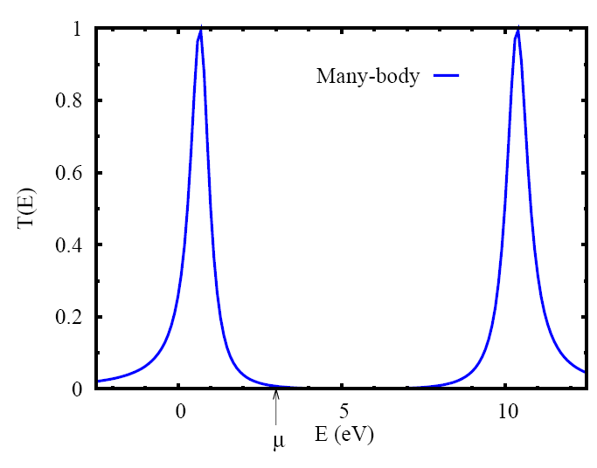
Exact spectrum from BA

Slide 38
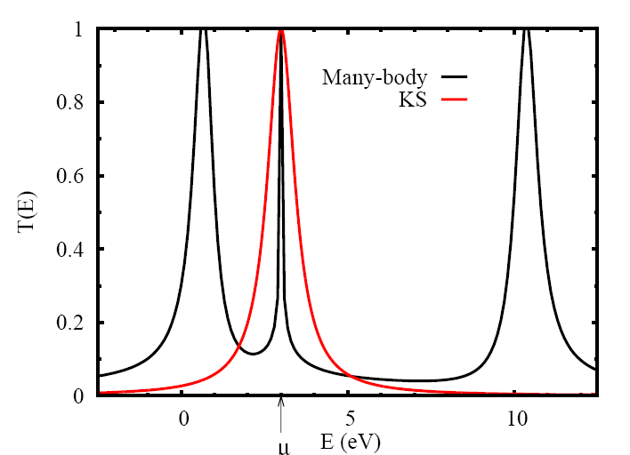
Exact spectrum from BA and from KS system

Slide 39
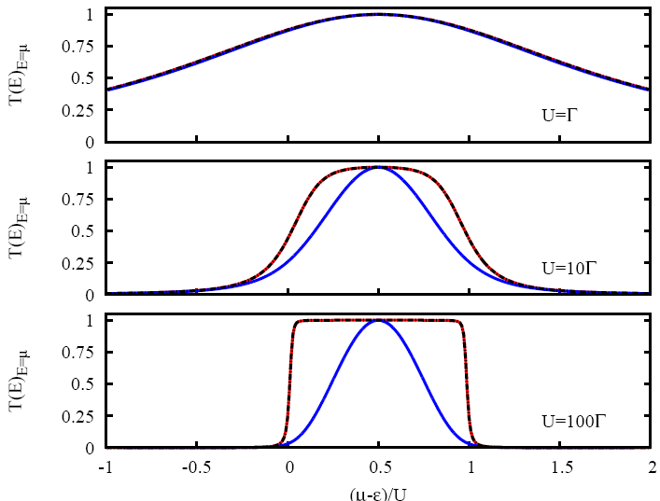
Transmission in HF and exact

Slide 40

KS on-site potential
Define:
so that <n_{c}> is exactly same as physical system!

Slide 41
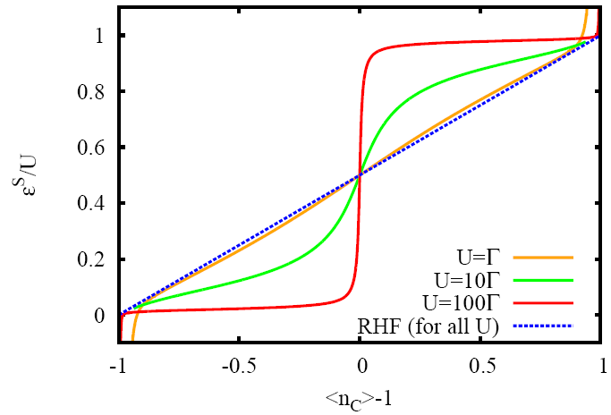
KS potential as function of U

Slide 42
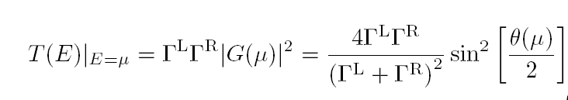

How general is this?
Anderson junction has only one channel through center, so
And
Independent of interaction (Friedel-Langreth rule).

Slide 43
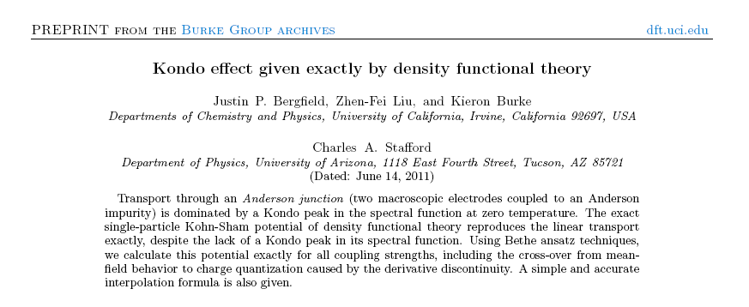
A hot topic
Appeared in PRL a few weeks ago
Evers and Schmitteckert (Apr 19, PCCP):
  Broadening of derivative discontinuity in DFT
Kurth and Stefanucci: (Chem Phys, appeared)
  TD bond-current functional theory for lattice Hamiltonians with apps to transport
Toster, Schmitteckert, and Evers: appeared PRB
  DFT-based transport calculations, Friedel’s sum rule and the Kondo effect.
Stefanucci and Kurth: PRL 2012
  Towards a description of Kondo effect in TDDFT

Slide 44
Performance of approximations
Disc=HF+explicit discontinuity produced by imposing particle-hole symmetry = mimic of LDA+U
To appear in PRB

Slide 45
Summary of Anderson junction
At zero temperature and weak bias limit, ground-state DFT yields exact Kondo transmission plateau for Anderson junction.
Likely, largest source of error is ground-state approximation, not corrections to standard model.
Thanks to students, collaborators, DOE, and David Langreth for inspiration.

Slide 46
Partition theory
Created by Adam Wasserman and Morel Cohen
3-4 papers with them and Peter Elliott

Slide 47
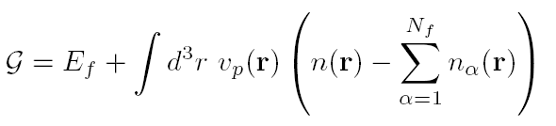
Basic partition theory
How to find minimum? Use Lagrange multipliers:
Lagrange multiplier is called partition potential, v_{p}(r), a global property of the molecule

Slide 48
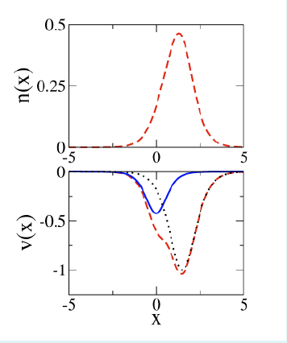
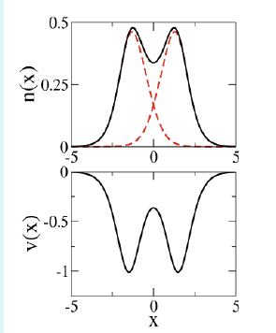
Partition potential
Each fragment density is the ground-state density in effective fragment potential, v_{α}(r)+v_{p}(r)

Slide 49
Why DFT approximations work at all?

Slide 50
Major ongoing project
Semiclassical derivations of density functional approximations.
Students: Peter Elliot (physics), Attila Cangi, Donghyung Lee, John Snyder (physics)
Collaborators: John Perdew (Tulane), Gus Scuseria (Rice), Hardy Gross (MPI Halle, Germany).

Slide 51
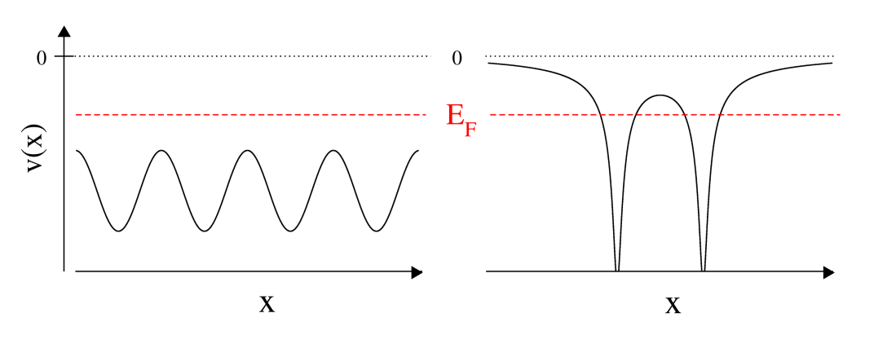
The unreasonable utility of asymptotic estimates: Why density functional theory works
Kieron Burke and friends
UC Irvine Chemistry and Physics
http://dft.uci.edu

Slide 52
Leading corrections to local approximations
Schwinger and Englert: Neutrals as Z->∞
  E(Z) = -0.768745 Z^{7/3} + ½ Z² – 0.269900 Z^{5/3}+ …
Unreasonably accurate, e.g., only 10% error for H
First term is exact in TF theory.
This is the same expansion:
  E(γ) = -0.768745 + ½ γ^{-1/3} – 0.269900 γ^{-2/3} + …

Slide 53
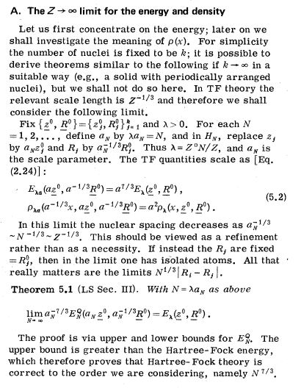
Lieb
Lieb (RMP, 1981) showed TF becomes relatively exact for all quantum matter (non-relativistic, etc.)
This is same limit!

Slide 54
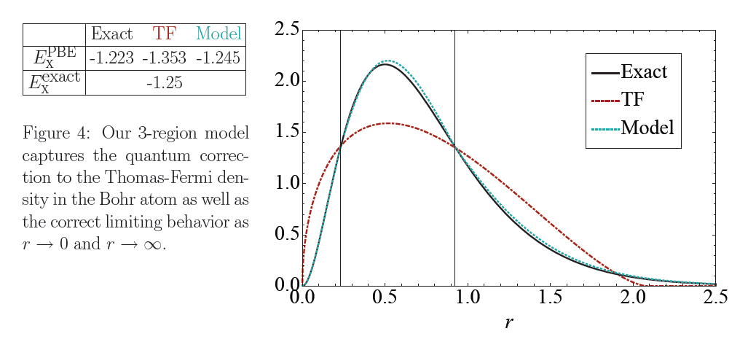
H from asymptotic corrections to Bohr atoms
From Ovadia’s thesis:

Slide 55
What is role of gradient expansion?
If system has no edges and no turning points at Fermi energy, then NO quantum corrections
Gradient expansion yields correct next-order
But this is special case of more general semiclassical small ħ expansion, which applies to ALL cases, and includes quantum oscillations which dominate over gradient corrections.
We’ve done it just to leading order. In next order, get leading gradient correction plus quantum gradient corrections.

Slide 56
Return to stretched H₂
Consider v_{s}(r) as function of bond length R
For exact KS potential, new turning points occur at about R=3.3 Å
Coulson-Fischer point (where spontaneous symmetry is broken) is 3.3 Å in LDA
Beyond that point (i.e., for strongly correlated systems), there is a different non-universal asymptotic expansion!
Failure of local-type approximations for strongly-correlated systems.

Slide 57
Quantum chemistry
Even the most fitted functionals do not produce mean average errors less than 2 kcal/mol.
There are also wild outliers, where the errors are much bigger.
Almost all chemical electronic structure calculations today (> 95%) are DFT, not wavefunction calculations.

Slide 58
E_{x} for neutral atoms
    E_{x}=-0.2208 Z^{5/3}-.195 Z + …
    Schwinger proved first term exact for LDA exchange.
    With GEA, get almost exactly ½ second coefficient
    All commonly-used GGA’s get second coefficient about right!
    Assuming equal contributions, Becke’s parameter in B88: β=5/(216 (6π⁵)^{1/3}) =.00378
    compare with .0042 from Becke’s fit

Slide 59
PBEsol
Most important idea: Restore gradient expansion for exchange!
Correlation fixed from jellium surface energy.
Screws up typical atomization energies, but reduces overcorrection of bond length.
AM05 gives comparable result with very different derivation.

Slide 60
Summary
Part I: Basic rules of exact DFT
Part II: Ways to approach strong correlation
  DMRG in 1d but with real-space
  Anderson junction tells us accurate functionals can give much useful info
  Partition theory: How to define U
  Continuum limit: Derive functionals to understand limits
Thanks to funders (mostly DOE) and students/collaborators

